Slide 1









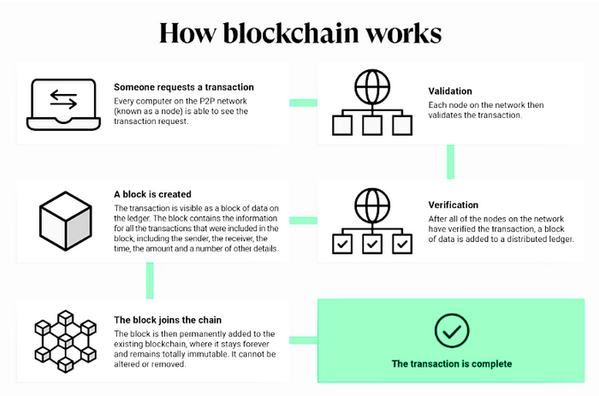










BLOCKCHAIN TECHNOLOGY
Team Silent Soldiers
Supervised by Professor Abdul Based
Presented by
Elias Ur Rahman, Adil Mahmoud Rion, Mursalatul Pallob
Introduction
SWOT analysis of Blockchain
Blockchain is a shared, immutable ledger that facilitates the process of recording transactions and tracking assets in a business network. An asset can be tangible (a house, car, cash, land) or intangible (intellectual property, patents, copyrights, branding). Virtually anything of value can be tracked and traded on a blockchain network, reducing risk and cutting costs for all involved.
STRENGTHS
WEAKNESSES
S
W
  Operational Efficiency
  Facilitates easier sharing of information about certain products
  Secure encryption and tamper-proof data storage
  Eliminates central authority
who has full access to the
data.
  Business rules change frequently, blockchain doesn’t.
  Blockchain is mostly not modular. An old encryption module cannot easily be replaced.
  Potentially in conflict with existing approaches to regulatory compliance, for example GDPR regulations.
  Concept isn’t easy to grasp for a newcomer. We need good education to make mass adoption possible.
Description
A blockchain was created by a person (or group of people) using the name (or pseudonym) Satoshi Nakamoto in 2008 to serve as the public distributed ledger for bitcoin cryptocurrency transactions, based on previous work by Stuart Haber, W. Scott Stornetta, and Dave Bayer.A blockchain is a type of distributed ledger technology (DLT) that consists of growing list of records, called blocks, that are securely linked together using cryptography. Each block contains a cryptographic hash of the previous block, a timestamp, and transaction data. Since each block contains information about the previous block, they effectively form a chain (compare linked list data structure), with each additional block linking to the ones before it. Consequently, blockchain transactions are irreversible in that, once they are recorded, the data in any given block cannot be altered retroactively without altering all subsequent blocks.
SWOT
OPPORTUNITIES
Analysis
THREATS
O
T
  Provides a platform for Big Data and analytic research.
  Gives back control to the user e.g. instead of Google and Facebook using your data, you can control who gets access to your data. All these permissions will be stored on the blockchain.
  The world is becoming more digital, so more people will accept the concept of blockchain in their daily lives.
  Scalability issues: too many transactions (overload), although several solutions are present.
  Unwanted centralization: mining pools and large mining farms
  Quantum computers (in the future) who have the ability to decrypt data.
  Hype and fast-changing environment
  There is always the possibility of mining attacks and hacks.
Key elements of a blockchain
Distributed ledger technology
1.
All network participants have access to the distributed ledger and its immutable record of transactions. With this shared ledger, transactions are recorded only once, eliminating the duplication of effort that’s typical of traditional business networks.
1.
Immutable records
The SDGs
No participant can change or tamper with a transaction after it’s been recorded to the shared ledger. If a transaction record includes an error, a new transaction must be added to reverse the error, and both transactions are then visible.
2.
1.
TRADITIONAL
DATABASE
VS
BLOCKCHAIN
Smart contracts
To speed transactions, a set of rules — called a smart contract — is stored on the blockchain and executed automatically. A smart contract can define conditions for corporate bond transfers, include terms for travel insurance to be paid and much more.
Database uses centralized storage of data
Blockchain uses decentralized storage of data.
3.
1.
Database needs a Database admin or Database administrator to manage the stored data.
There is no administrator in Blockchain
Modifying data requires permission from the database admin.
Blockchain is irresistible to modification of data.
Applications of Blockchain
Centralized databases keep information that is up-to-date at a particular moment
Blockchain keeps the present information as well as the past information that has been stored before.
  Supply chain
  Healthcare
  Government
  Retail
  Media and advertising
  Oil and gas
  Telecommunications
  Manufacturing
  Insurance
  Financial services
  Travel and transportation
Centralized databases are used as databases for a really long time and have a good performance record, but are slow for ertain functionalities.
Blockchain is ideal for transaction platforms but it slows down when used as a database, especially with a large collection of data.
Conclusion
Blockchain is a brand-new, reliable technology. Blockchain still has a lot of potential and time to develop and become a better alternative for all security-based systems. People just need to let this technology flourish and make everyone safer.

